Slide 1
Handwritten Text Recognition
Presented by: Akankshi Mody | Mohini Agarwal | Logan Liu | Shane Kok

Slide 2
Introduction

Slide 3

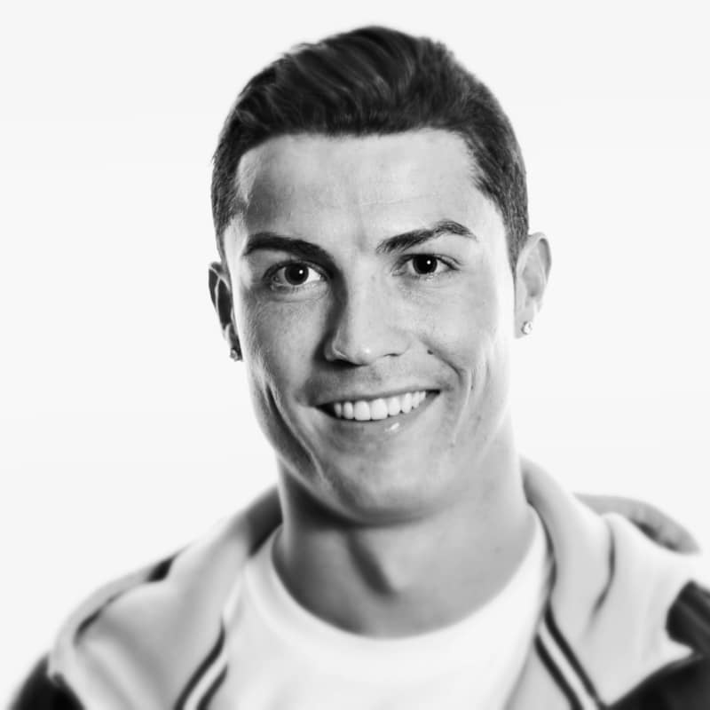
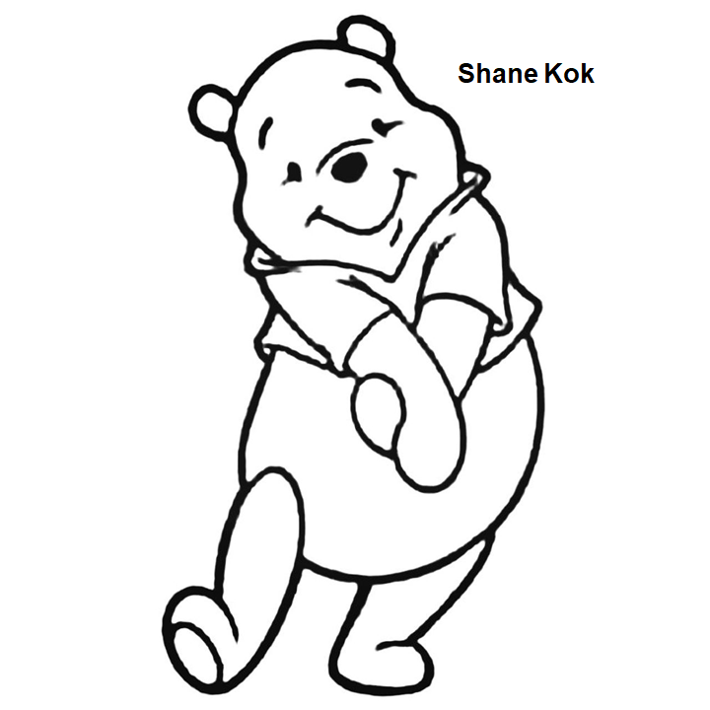

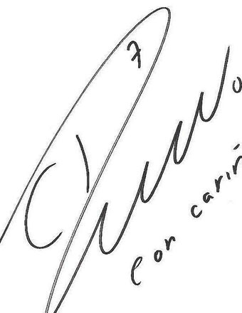
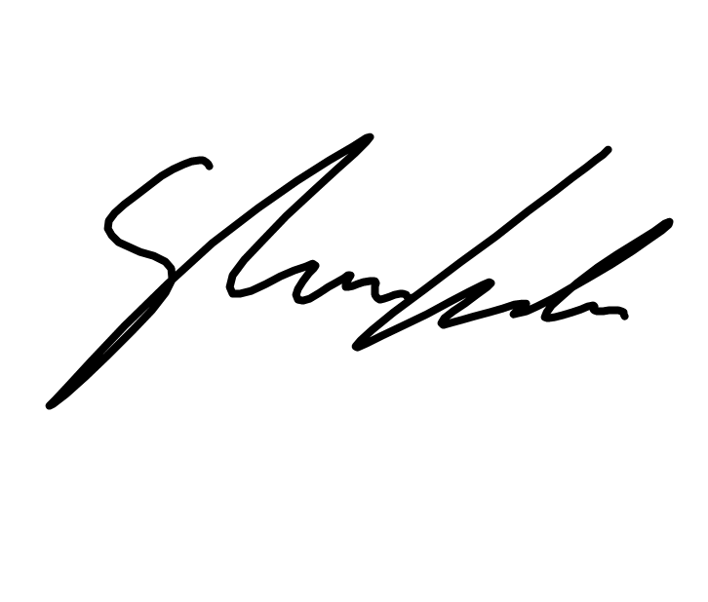
Creative Signatures
Handwriting recognition is a challenging problem due to huge variation in individual writing styles.
Singer-songwriter
Soccer Player
Someone You Know

Slide 4
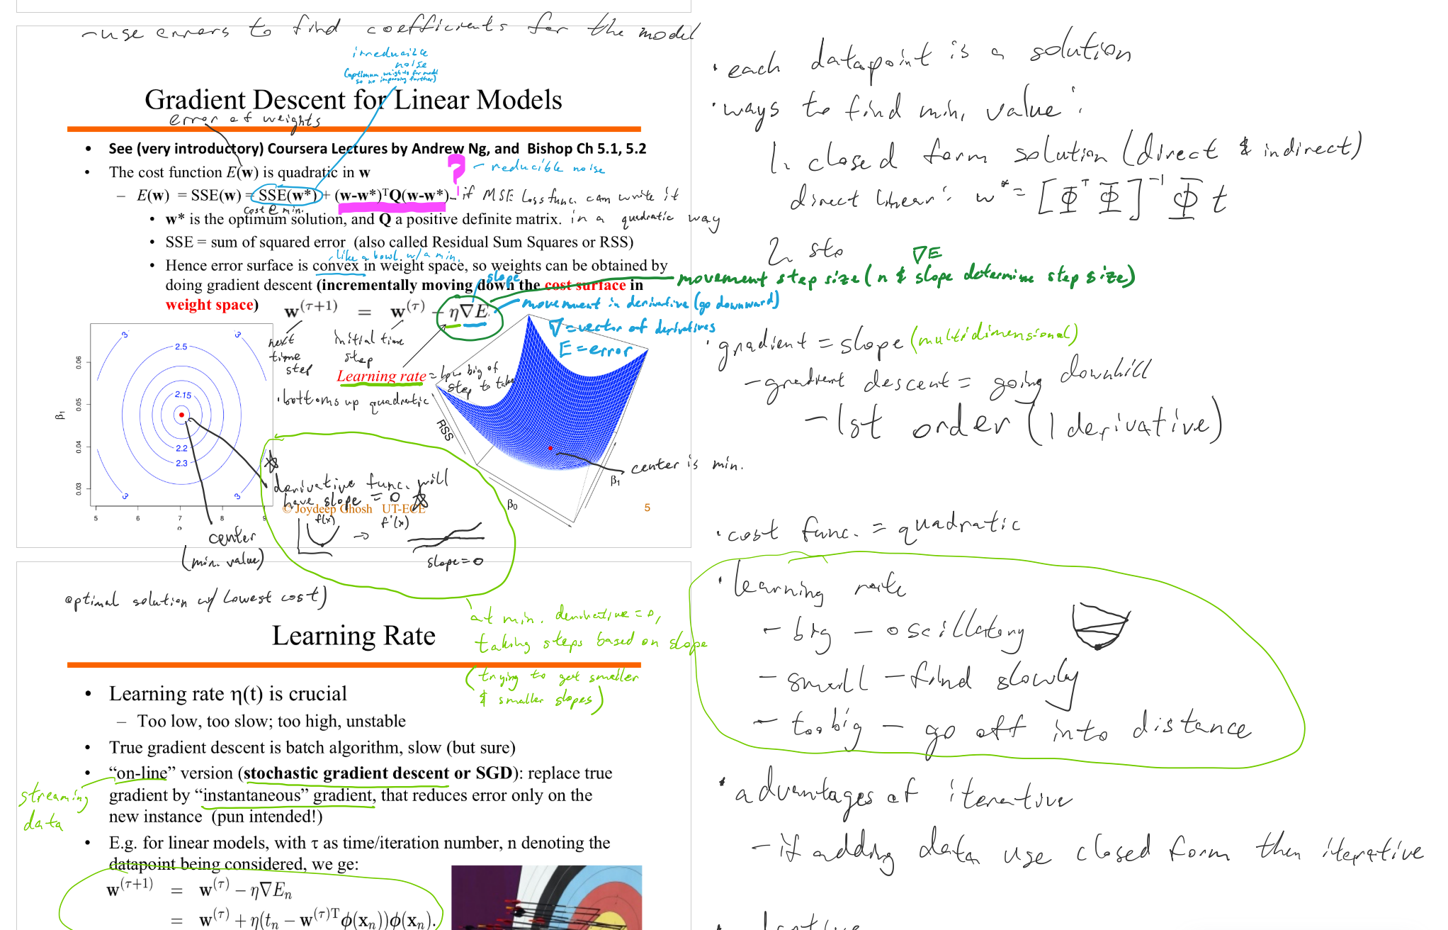
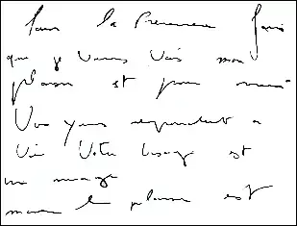
Handwriting Samples

Slide 5
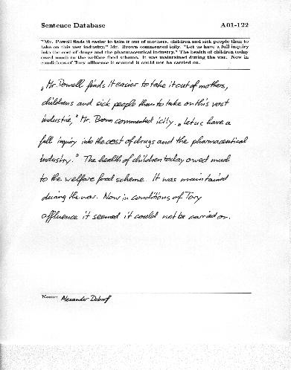
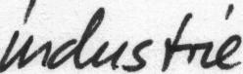
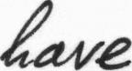
Dataset & Structure
The IAM Handwriting Database contains forms of handwritten English text which can be used to train and test handwritten text recognizers and to perform writer identification and verification experiments.
657
writers
contributed samples of their handwriting
13'353
text lines
isolated and labeled
115'320
words
isolated and labeled

Slide 6
Approaches

Slide 7
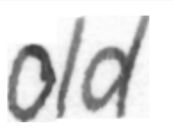


Simple Approach-1
KNN
[1]
[2]
[3]
[‘o’]
[‘l’]
[‘d’]
[‘o’]
[‘l’]
[‘d’]
[1]
[2]
[3]
[‘old’]

Slide 8
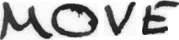
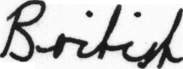
Challenges
Bounding box looks for gaps in the words

Slide 9




Simple Approach-2
[‘M’]
[‘O’]
[‘V’]
[‘E’]
CNN with Tensorflow
2 layers
[‘MOVE’]
57% accuracy

Slide 10
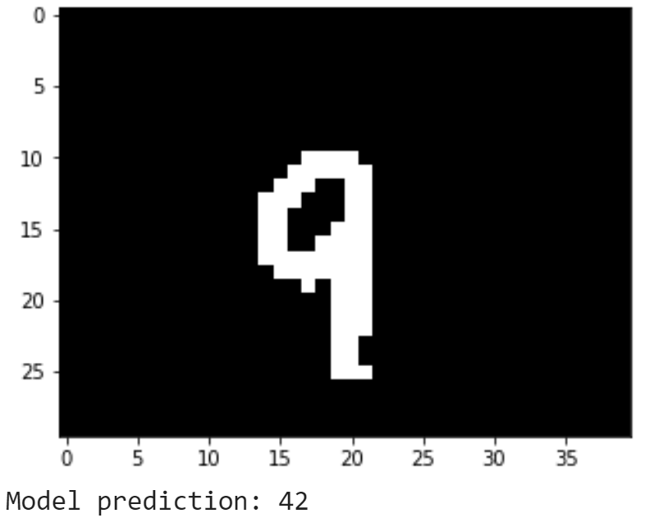
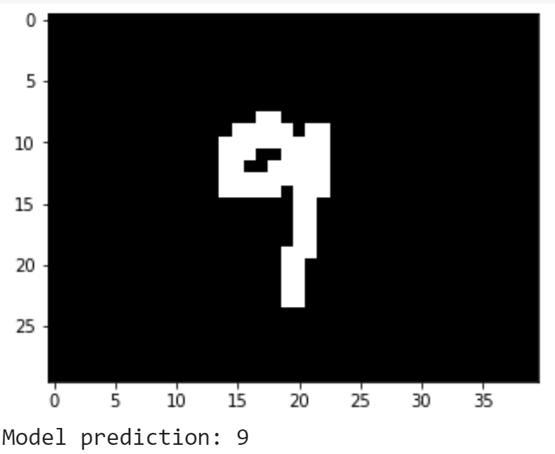
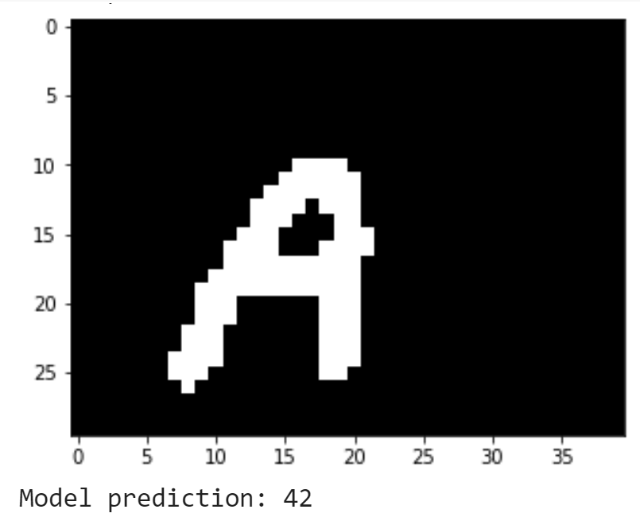
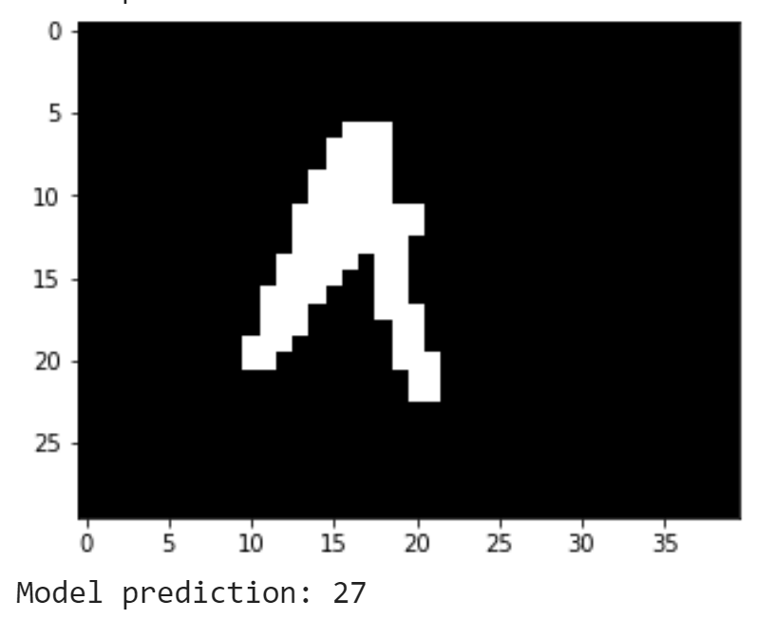
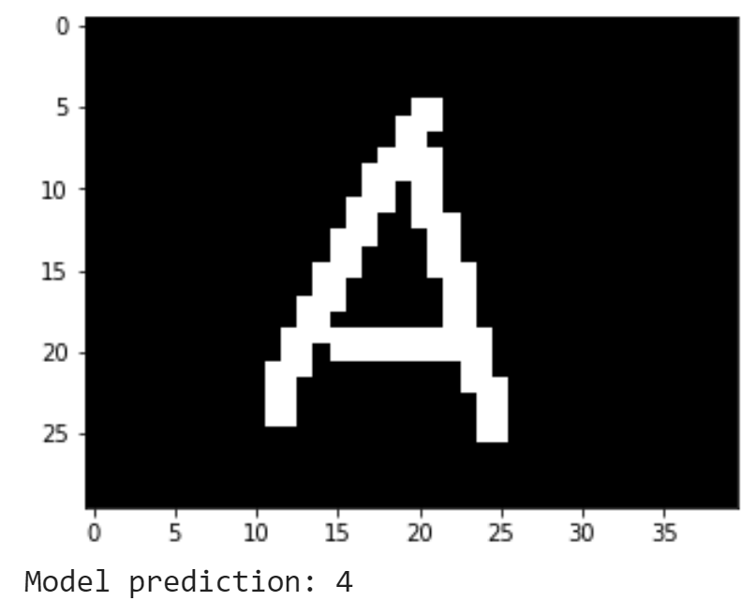
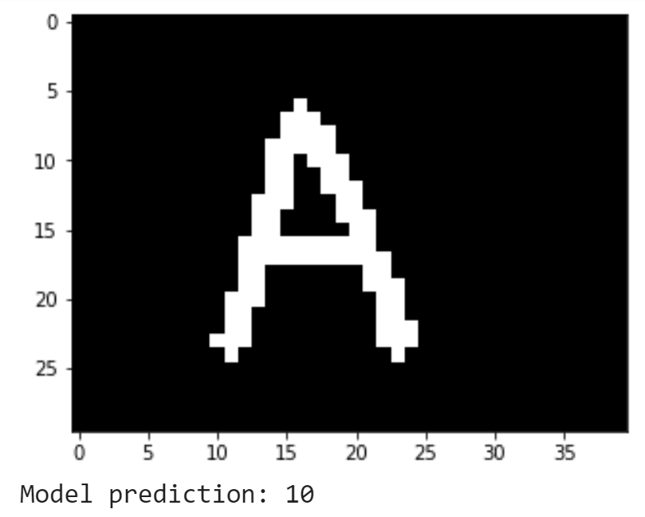
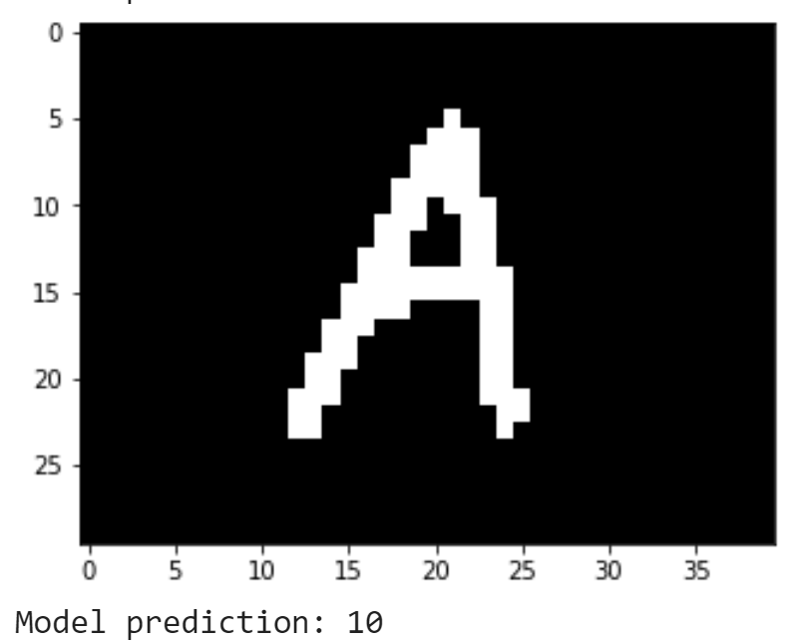
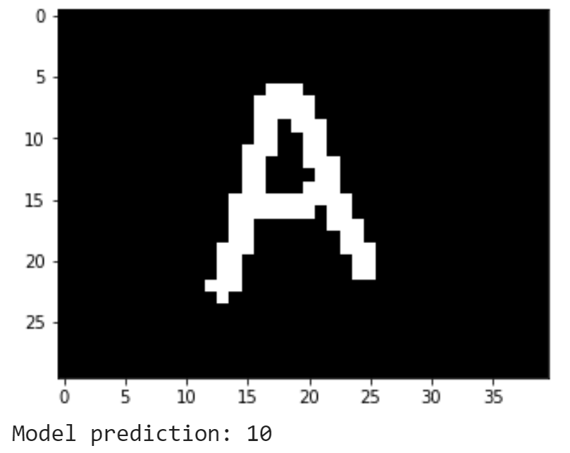
Challenges-1
42 == ‘g’
9 == ‘9’
42 == ‘g’
27 == ‘R’
4 == ‘4’
10 == ‘A’

Slide 11
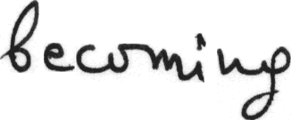
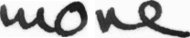
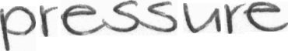
Challenges-2
Handwriting varies vastly across the train (characters only dataset) and test data (IAM dataset)
Handwriting varies vastly across the test data itself (IAM dataset)

Slide 12

Harald Scheidl
Handwritten Text Recognition in Historical Documents
Word Beam Search: A Connectionist Temporal Classification Decoding Algorithm
Notes:
Word Beam Search: A Connectionist Temporal Classification Decoding Algorithm

Slide 13
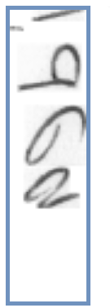
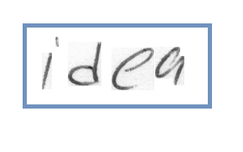
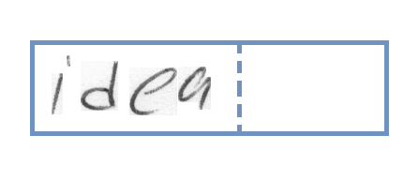
Data Preprocessing
Original Images of different sizes, Grayscale
Transposed to match NN dimensions & Normalization
Resize to 128 X 32

Slide 14
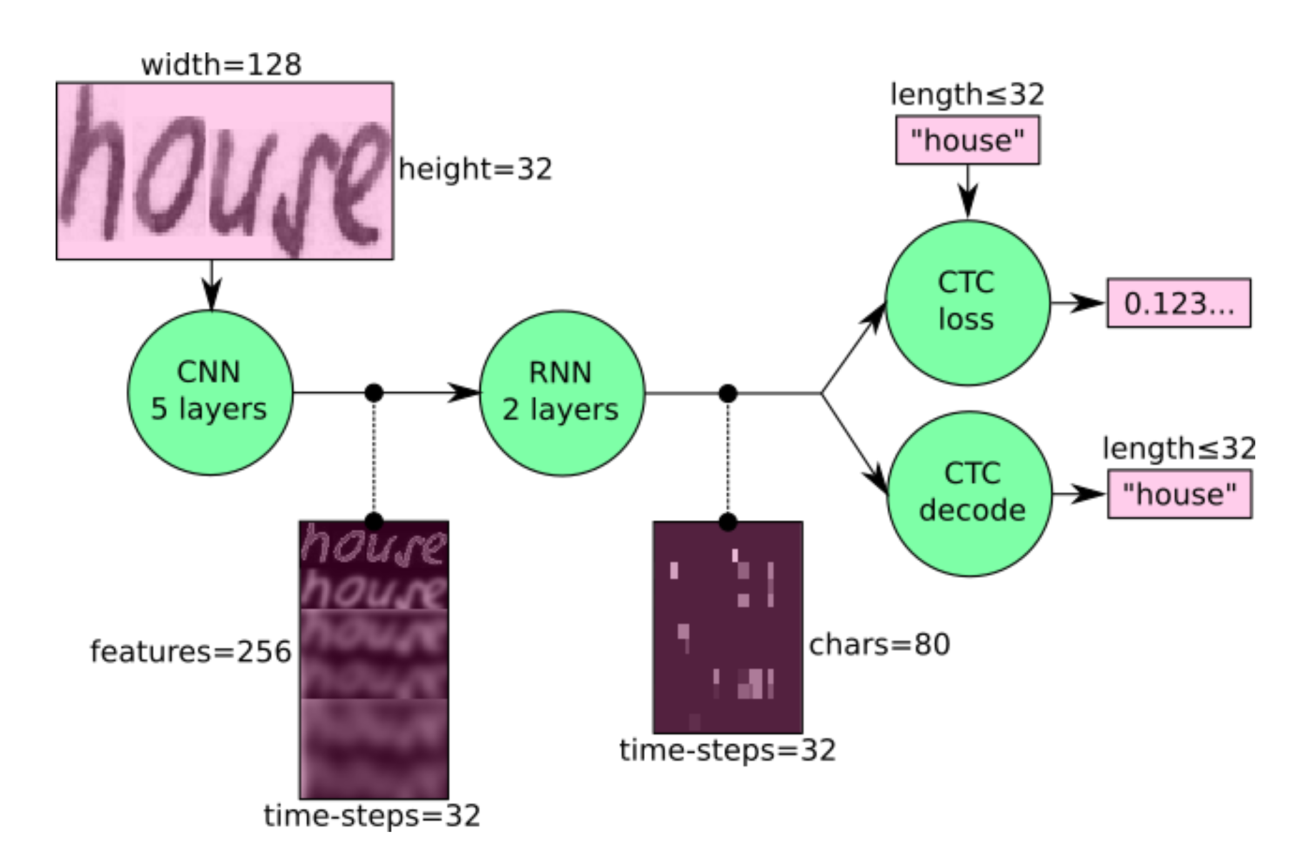
Deep Learning Approach
https://github.com/githubharald/SimpleHTR
Notes:
the text is recognized on character-level, therefore words or texts not contained in the training data can be recognized too (as long as the individual characters get correctly classified).

Slide 15
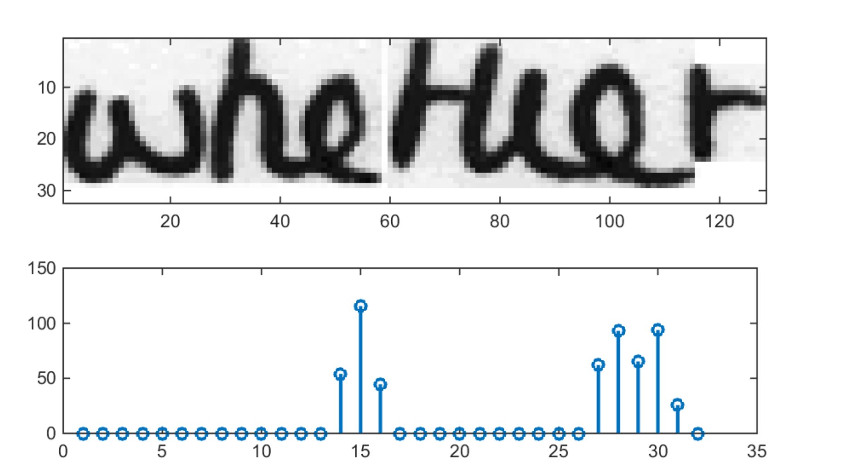
Convolutional Neural Network
Convolution: Filter kernel 5X5 in first two layers, 3X3 in the last three layers
RELU Non-Linear activation
Max-pooling to get output feature map of 32 X 256
https://towardsdatascience.com/build-a-handwritten-text-recognition-system-using-tensorflow-2326a3487cd5
Notes:
Each entry contains 256 features. Of course, these features are further processed by the RNN layers, however, some features already show a high correlation with certain high-level properties of the input image: there are features which have a high correlation with characters (e.g. “e”), or with duplicate characters (e.g. “tt”), or with character-properties such as loops (as contained in handwritten “l”s or “e”s).

Slide 16
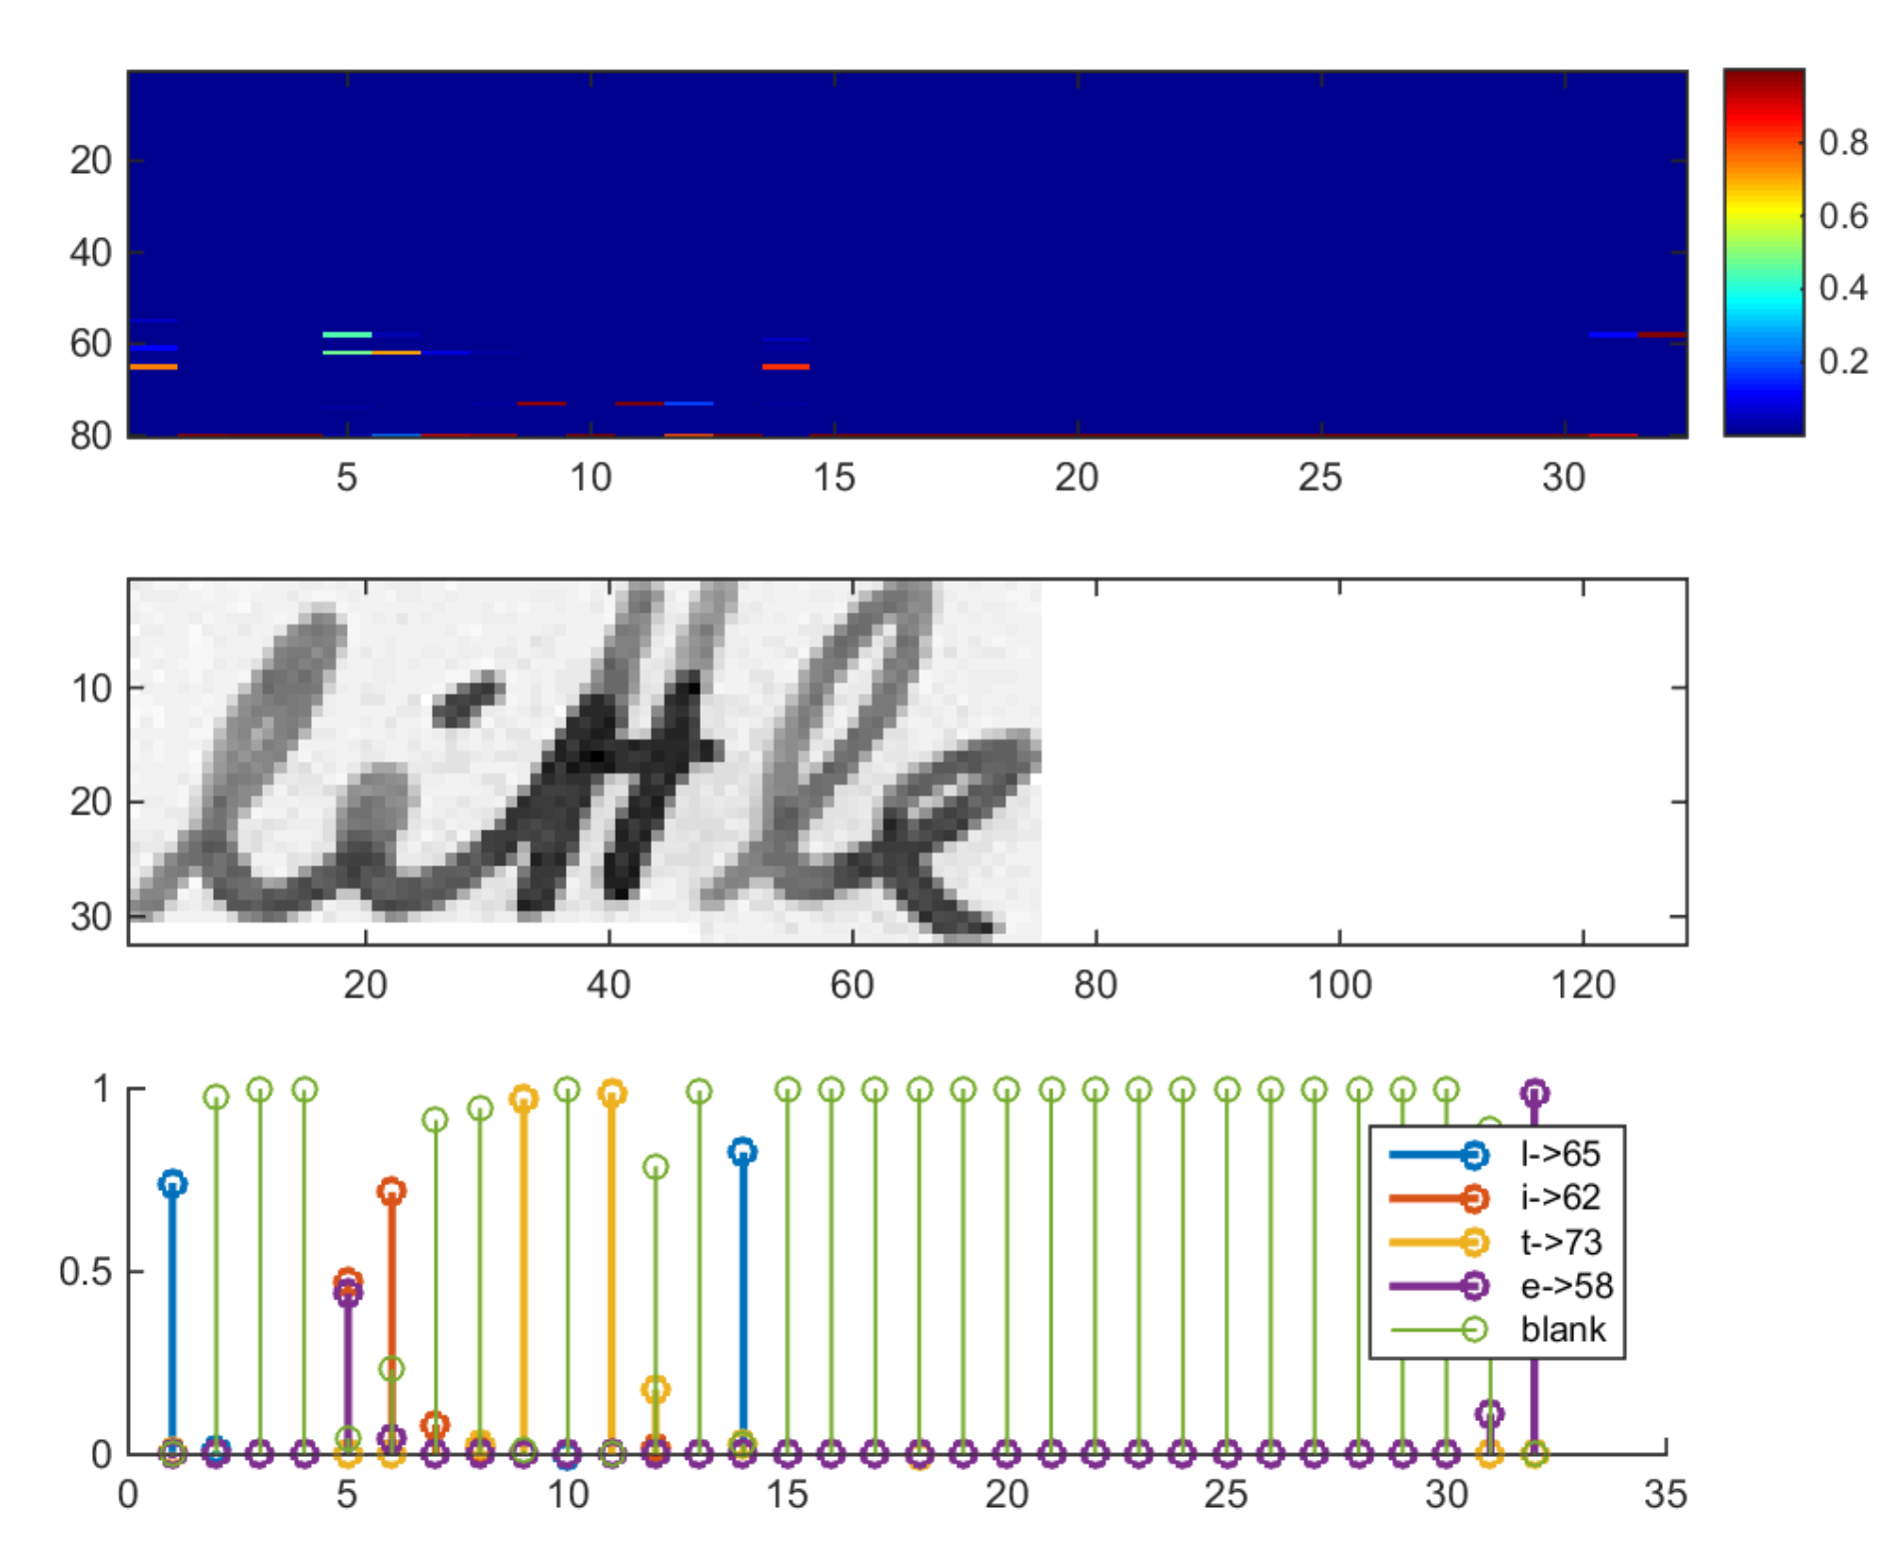
Recurrent Neural Network
256 features per time step
LSTM implementation of RNN
Output sequence mapped to a matrix of size 32×80
79 characters from IAM + 1 CTC blank character
https://towardsdatascience.com/build-a-handwritten-text-recognition-system-using-tensorflow-2326a3487cd5
Notes:
The matrix shown in the top-most graph contains the scores for the characters including the CTC blank label as its last (80th) entry. The other matrix-entries, from top to bottom, correspond to the following characters: “ !”#&’()*+,-./0123456789:;?ABCDEFGHIJKLMNOPQRSTUVWXYZabcdefghijklmnopqrstuvwxyz”. It can be seen that most of the time, the characters are predicted exactly at the position they appear in the image (e.g. compare the position of the “i” in the image and in the graph). Only the last character “e” is not aligned. But this is OK, as the CTC operation is segmentation-free and does not care about absolute positions. From the bottom-most graph showing the scores for the characters “l”, “i”, “t”, “e” and the CTC blank label, the text can easily be decoded: we just take the most probable character from each time-step, this forms the so called best path, then we throw away repeated characters and finally all blanks: “l---ii--t-t--l-…-e” → “l---i--t-t--l-…-e” → “little”.

Slide 17
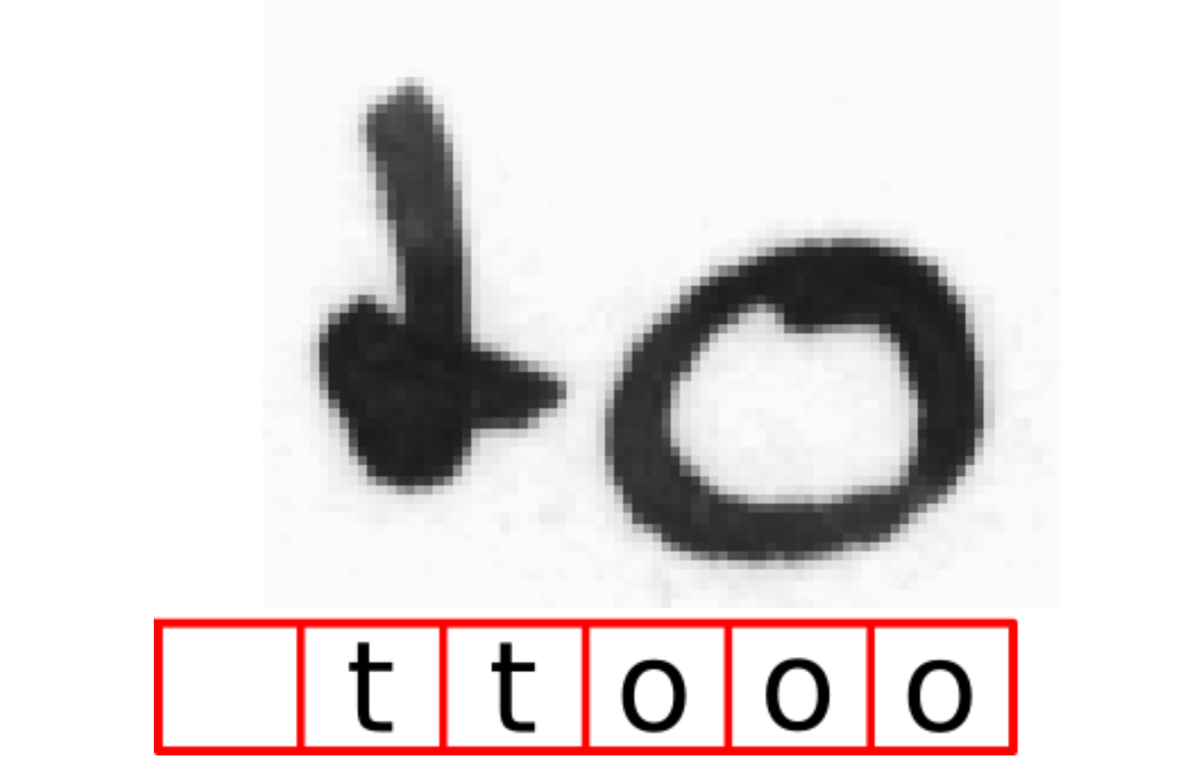
Connectionist Temporal Classification Loss
https://towardsdatascience.com/intuitively-understanding-connectionist-temporal-classification-3797e43a86c
Notes:
there are two problems with this naive solution:
it is very time-consuming (and boring) to annotate a data-set on character-level.
we only get character-scores and therefore need some further processing to get the final text from it. A single character can span multiple horizontal positions, e.g. we could get “ ttooo” because the “o” is a wide character as shown in Fig. 2. We have to remove all duplicate “t”s and “o”s. But what if the recognized text would have been “too”? Then removing all duplicate “o”s gets us the wrong result. How to handle this?

Slide 18
How CTC Decoding Works
CTC Blank (-) Label
Repetition Characters in the input image
Proxy character used to indicate the separation between characters in input image
Handles input images with characters occurring multiple times such as ‘too’
Handling Duplicates in the Output
Converts outputs such as ‘ttooooo’ by removing duplicates to ‘to’

Slide 19
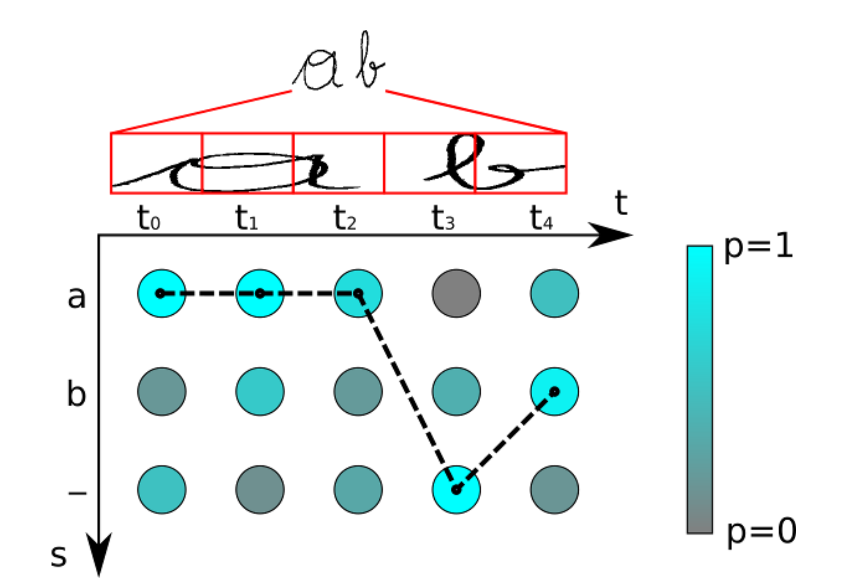
Connection Temporal Classification Loss
https://towardsdatascience.com/intuitively-understanding-connectionist-temporal-classification-3797e43a86c
Notes:
The characters are “a”, “b” and “-” (blank). There are 5 time-steps. Let’s apply our best path decoder to this matrix: the most likely character of t0 is “a”, the same applies for t1 and t2. The blank character has the highest score at t3. Finally, “b” is most likely at t4. This gives us the path “aaa-b”. We remove duplicate characters, this yields “a-b”, and then we remove any blank from the remaining path, which gives us the text “ab” which we output as the recognized text.

Slide 20


Slide 21
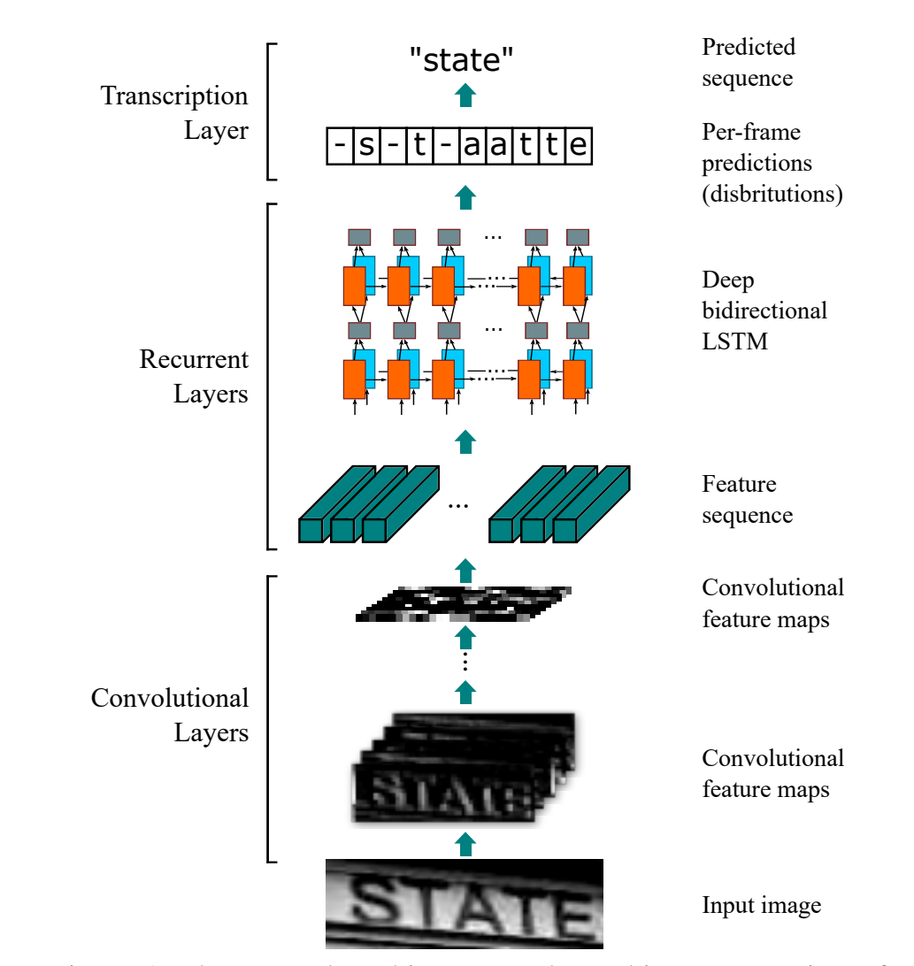
Bringing it Altogether
Shi - An End-to-End Trainable Neural Network for Image-based Sequence Recognition and Its Application to Scene Text Recognition

Slide 22
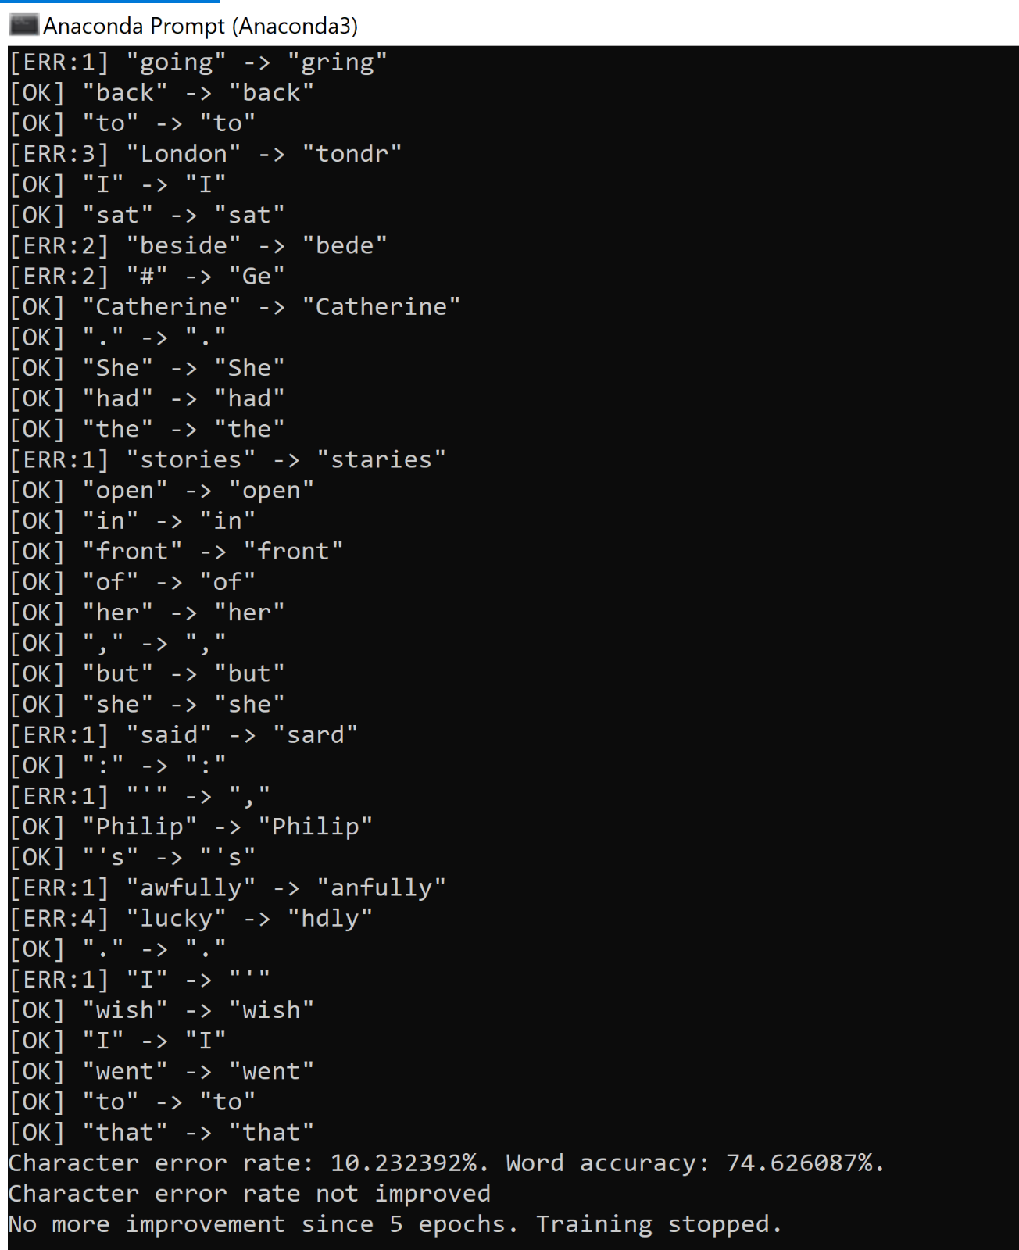
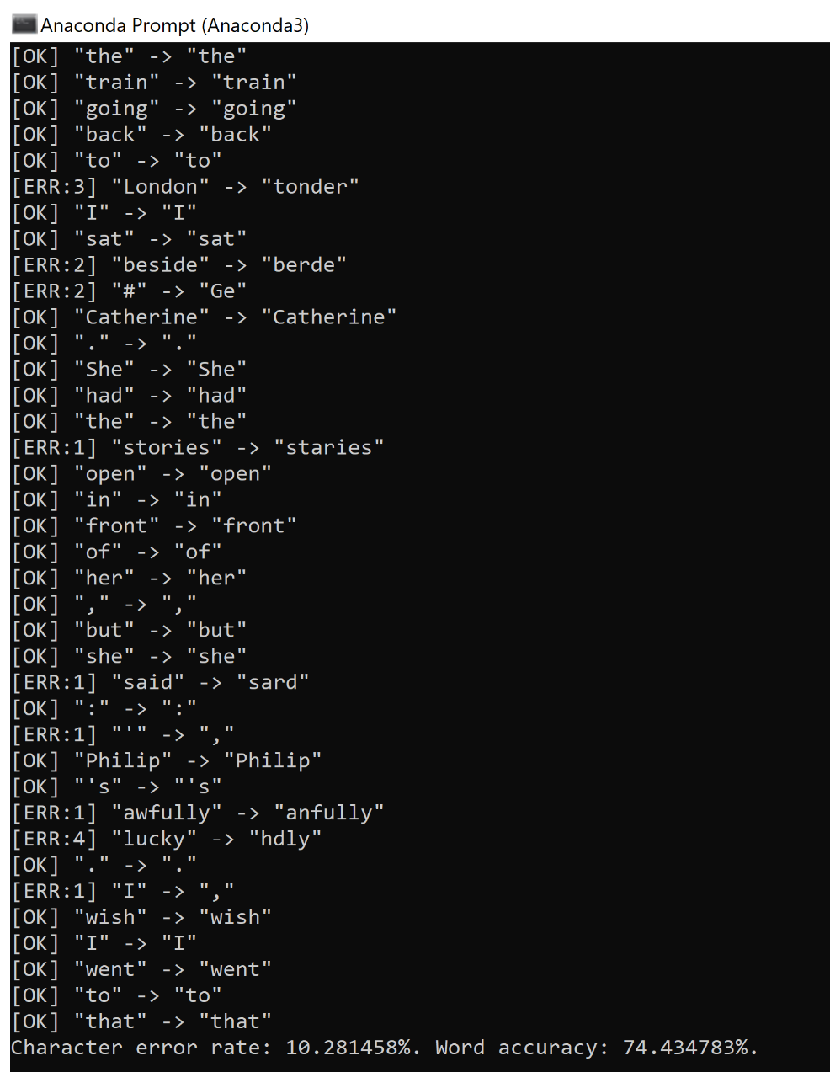
Running the Models
Gradient Descent Optimizer
RMSProp Optimizer
Notes:
The RMSprop optimizer is similar to the gradient descent algorithm with momentum. The RMSprop optimizer restricts the oscillations in the vertical direction. Therefore, we can increase our learning rate and our algorithm could take larger steps in the horizontal direction converging faster. The difference between RMSprop and gradient descent is on how the gradients are calculated. The following equations show how the gradients are calculated for the RMSprop and gradient descent with momentum.
Sometimes the value of v_dw could be really close to 0. Then, the value of our weights could blow up. To prevent the gradients from blowing up, we include a parameter epsilon in the denominator which is set to a small value.

Slide 23
Conclusion

Slide 24
Lessons Learned
PRE-PROCESSING
Preprocessing Images
Grey-scaled
Resized Dimensions
Fixing Kernel Striding Window Size
Transposed
MODELS
RNN+CNN Models
CNN performs well on images
RNN helps to learn better for sequential models

Slide 25
Future Steps
Data Augmentation
Match real world variances in handwriting by applying random transformations
Increase Input Size
Improve the model to identify and read sentences and full passages
Experiment with Neural Networks
Experimenting with various optimizers
Testing different numbers of layers
Change Decoding Method
Explore Token Passing or Word beam search
Text Correction
If a word is not learned in training, refer to corpus of words
Notes:
Data augmentation: increase dataset-size by applying further (random) transformations to the input images. At the moment, only random distortions are performed.
Increase input size (if input of NN is large enough, complete text-lines can be used, see lamhoangtung/LineHTR).
Add more CNN layers.
Replace LSTM by 2D-LSTM.
Replace optimizer: Adam improves the accuracy, however, the number of training epochs increases (see discussion).
Decoder: use token passing or word beam search decoding [4] (see CTCWordBeamSearch) to constrain the output to dictionary words.
Text correction: if the recognized word is not contained in a dictionary, search for the most similar one.

Slide 26



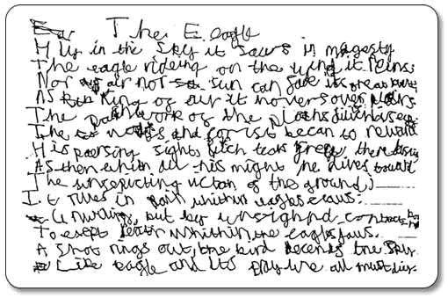
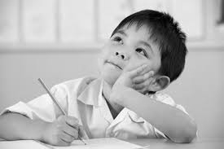
Future Business Applications
Teach Kids to
Improve Handwriting
Recognize and Interpret Dyslexic Handwriting
write another line here
entrepreneurial activities differ substantially depending on the type of organization and creativity involved. entrepreneurship ranges in scale from solo. entrepreneurial activities differ substantially depending on the type of organization and creativity involved.
Provide Writing Recommendations based on Author Profiles

Slide 27
Thank You!
Questions?

